Slide 1
Qrious -
Beauty
Catergorization
BUY NOW
BUY NOW
BUY NOW
Daniel, JungKyu, Mhonika, Mishika, Usha
BUY NOW

Slide 2
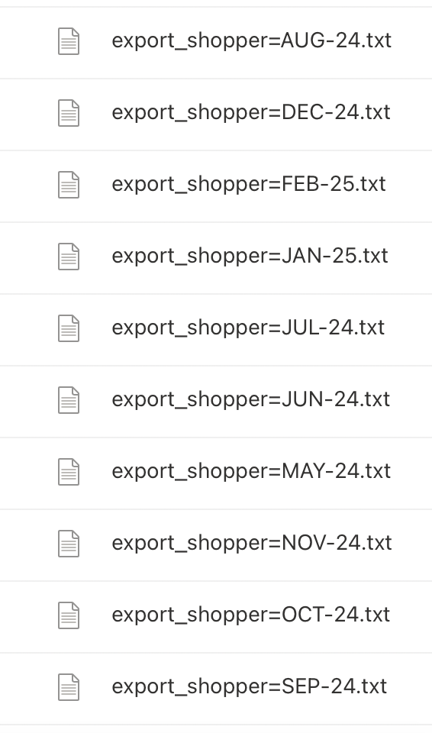
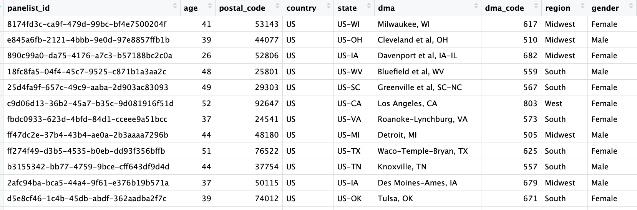
Data Overview
Data from May ‘24 - Feb ‘25
May – July: Amazon
August – September: Amazon + Walmart
October onwards: Amazon + Walmart + Target.
Notes:
Daniel

Slide 3
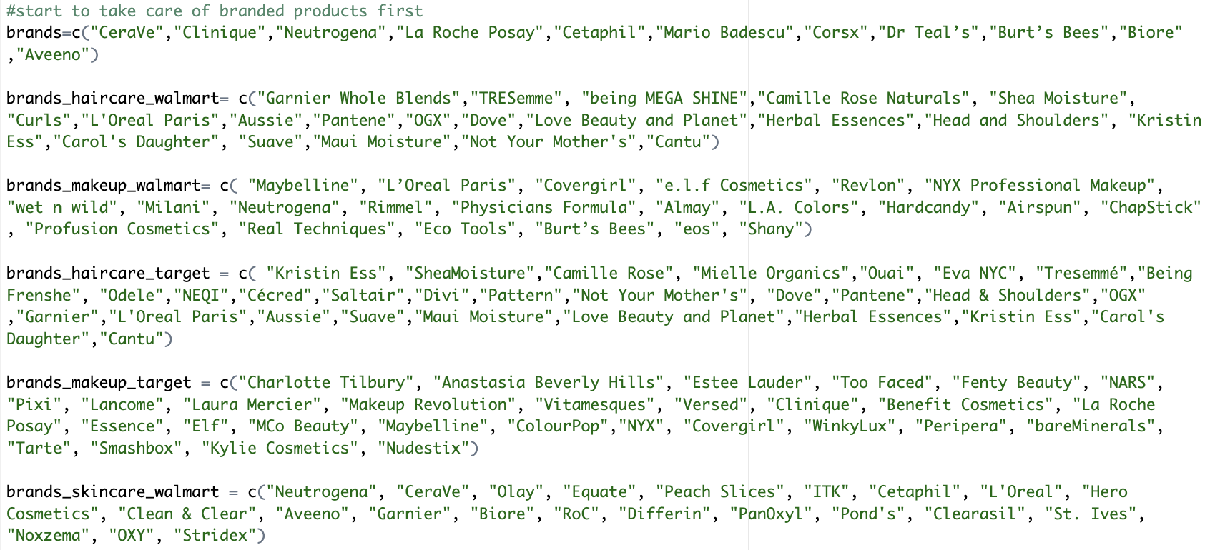
Data Categorization
Keyword-based Classification
Created a dictionary of beauty brand names that are unique and specific to the category
Converted Brand names to lowercase for consistent processing
Fixing brand name to the front of product name to ensure accurate filtering
Notes:
daniel

Slide 4
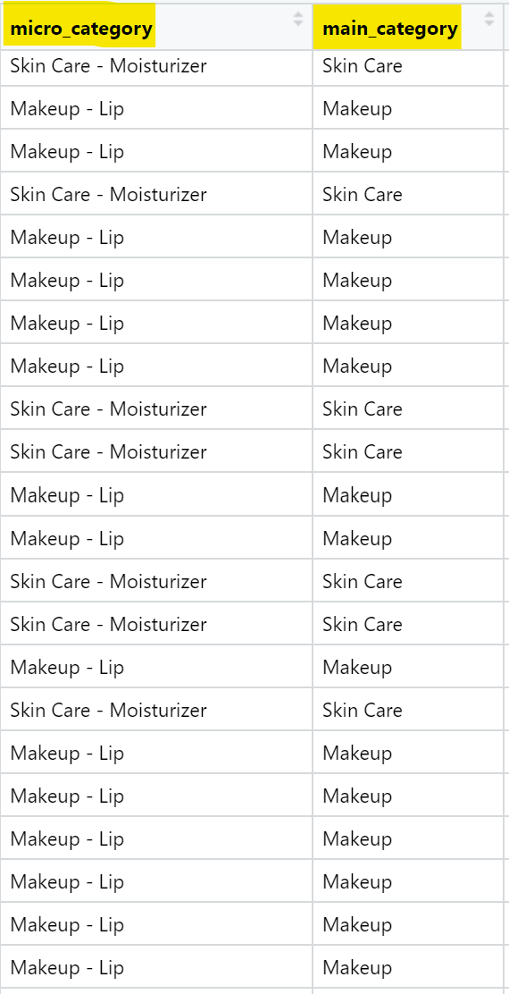
Data Categorization
Keyword-based Classification
Converted Brand names to lowercase for consistent processing
Automatically classified into micro categories using predefined keywords (Eg. “cleanser”, “serum”, “foundation”)
Supplemented with brand name matching to minimize “NA” cases
Covered niche categories (Deodorant, shaving, nail, beauty tools) with precision
Advantages
Cost Efficiency: No external APIs or expensive server setups needed
Time Efficiency: Automated classification of thousands of products within minutes
High Accuracy: Clear, rule-based logic ensured consistent and complete categorization
Scalability: Easily adaptable by updating or expanding keyword rules
Notes:
Daniel
We built a rule-based classification system with LLM-assisted keyword discovery to categorize product names into domain-specific micro-categories. This system ensures both consistency and flexibility in scaling categorization logic.

Slide 5
Data Categorization
Based on randomised sample of 50 items per main category
Main Catergory | Accuracy
Beauty Tools | 98%
Body Care | 100%
Hair Care | 64%
Makeup | 80%
Nail Care | 100%
Skin Care | 60%

Slide 6
Analysis

Slide 7
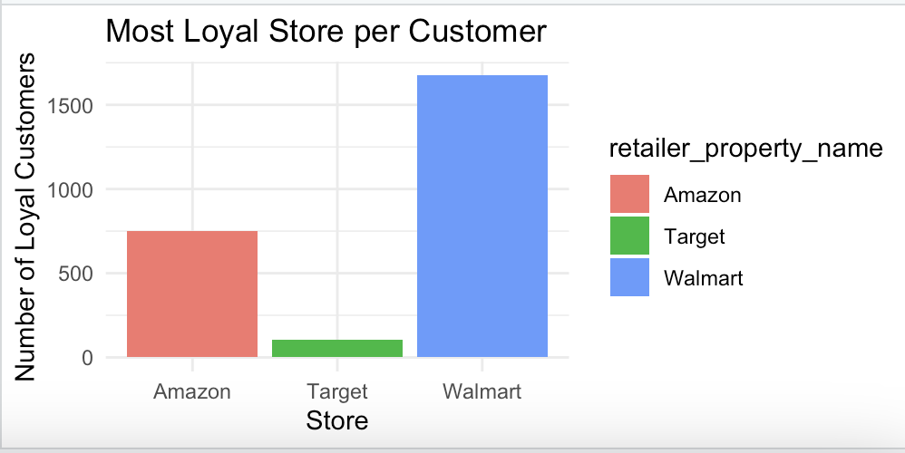
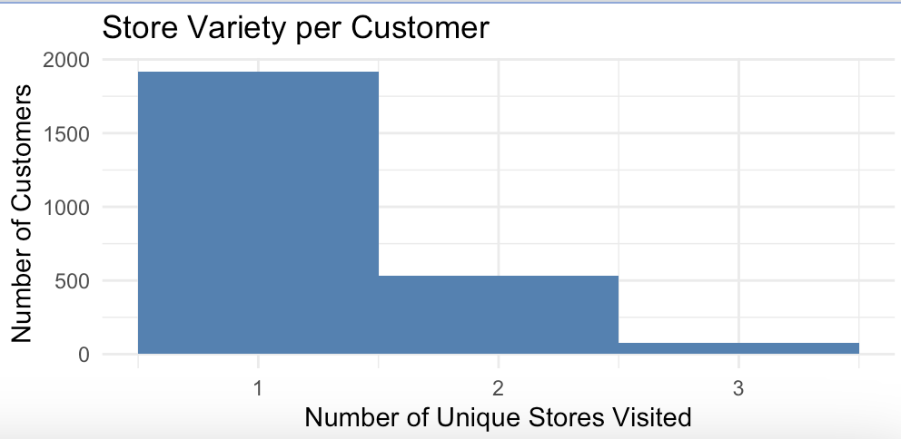
Customer Loyalty Overview Across Major Retailers
Graph 1:
shows that Amazon has the largest loyal customer base, followed by Walmart and Target.
Graph 2:
reveals that most customers shop at only 1 or 2 stores, suggesting a high degree of brand/store loyalty.
This indicates that many users consistently return to their favorite store, instead of shopping around.
Notes:
daniel

Slide 8
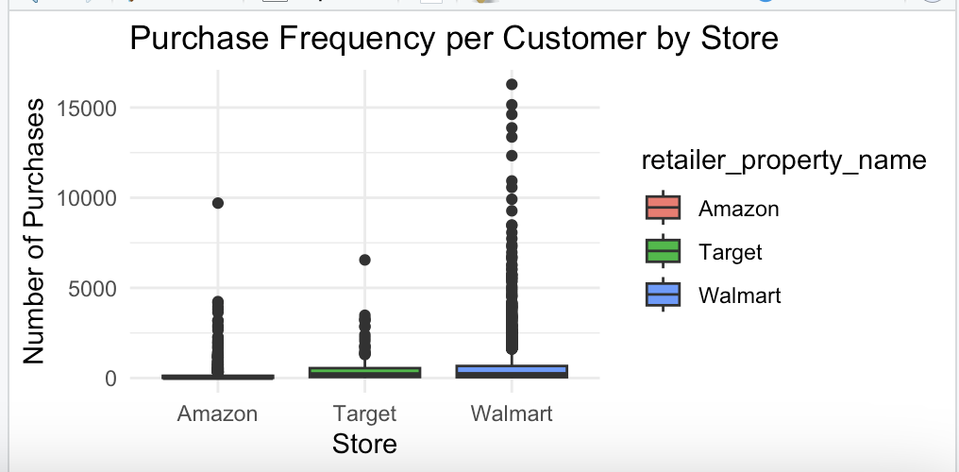
How Strong Is Customer Loyalty?
shows how frequently loyal customers shop at each store.
Amazon has the highest median purchase frequency, indicating strong recurring buying behavior.
Target and Walmart also show loyal users, but with more variability.
This helps us conclude that Amazon not only has more loyal customers, but they also buy more often.
Notes:
da

Slide 9
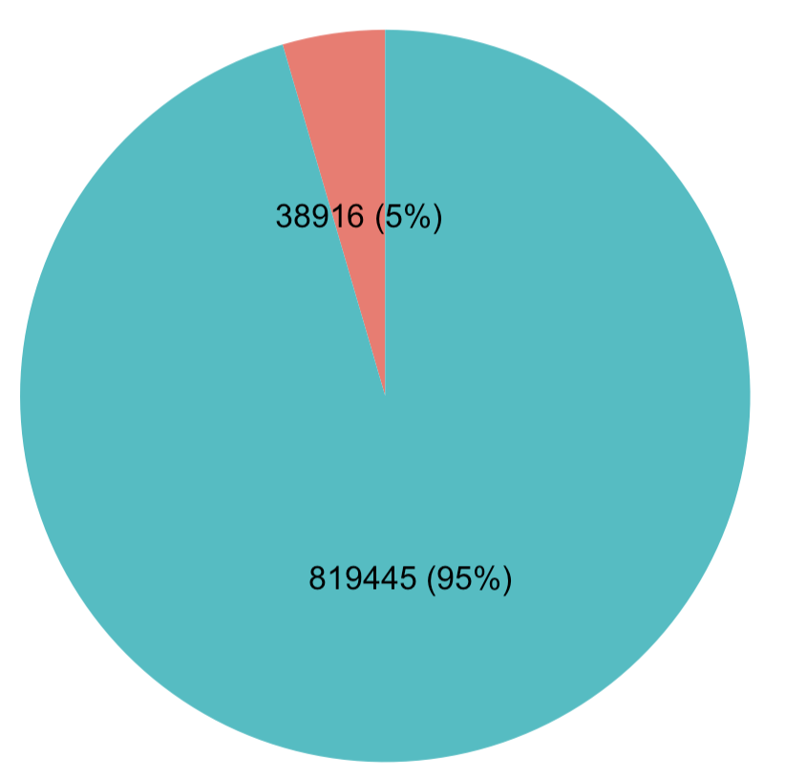
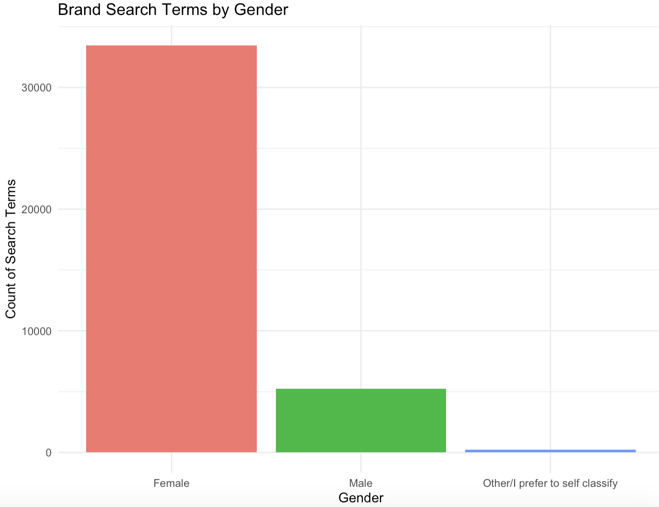
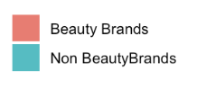
Proportion of Search terms
Only 5% of search terms contain beauty brands
Mainly females search specific beauty brands
Notes:
Mhon

Slide 10
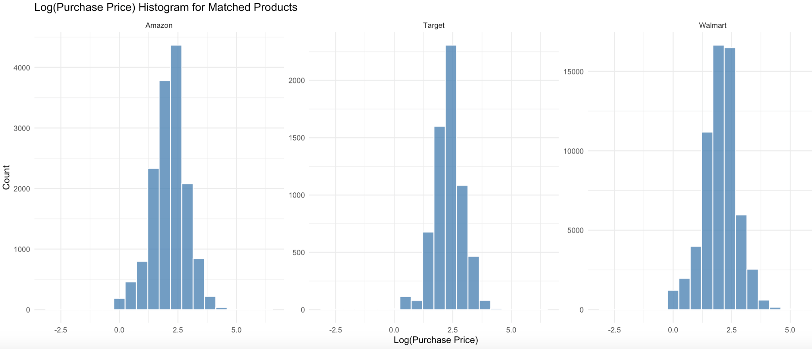
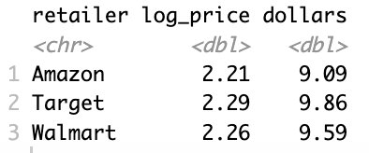
Average Price of Beauty products
Log(Purchase Price) distribution is similar across all stores
Range: $9 - $10, with Amazon’s average price being the lowest at $9.09
Notes:
Mhon

Slide 11
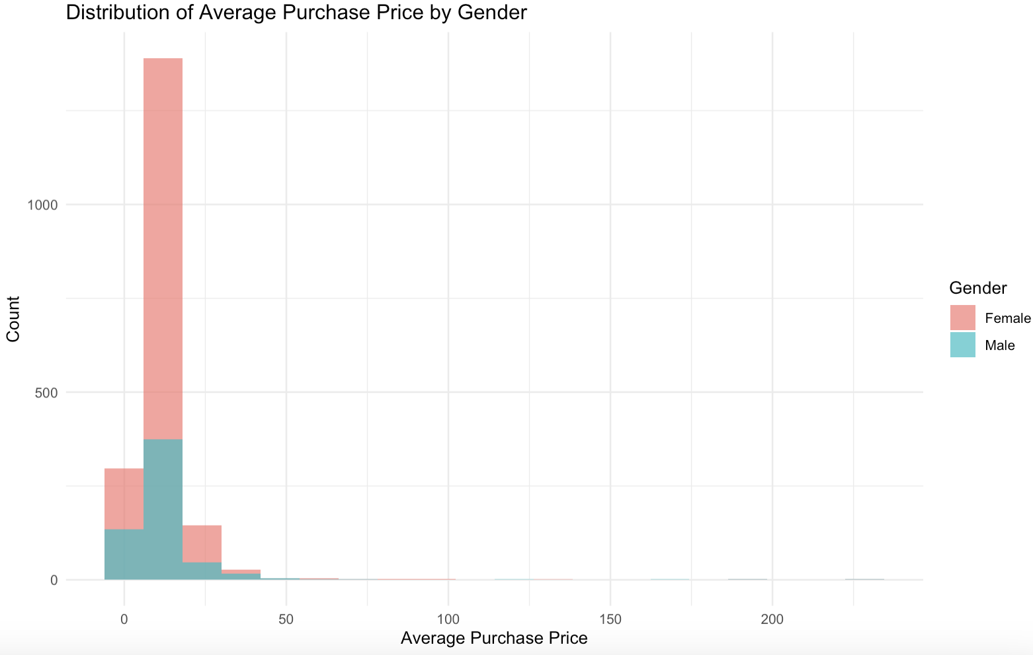
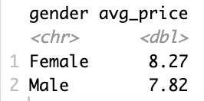
Average Price distribution by Gender
Both genders have a similar distribution to the average price of beauty products
Females average price is slightly higher by about 50 cents

Slide 12
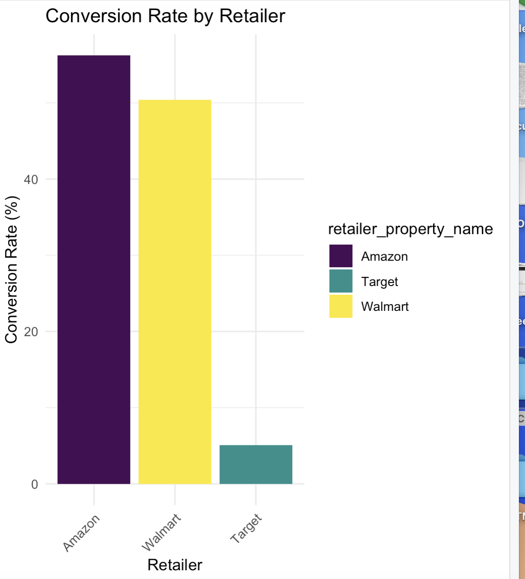
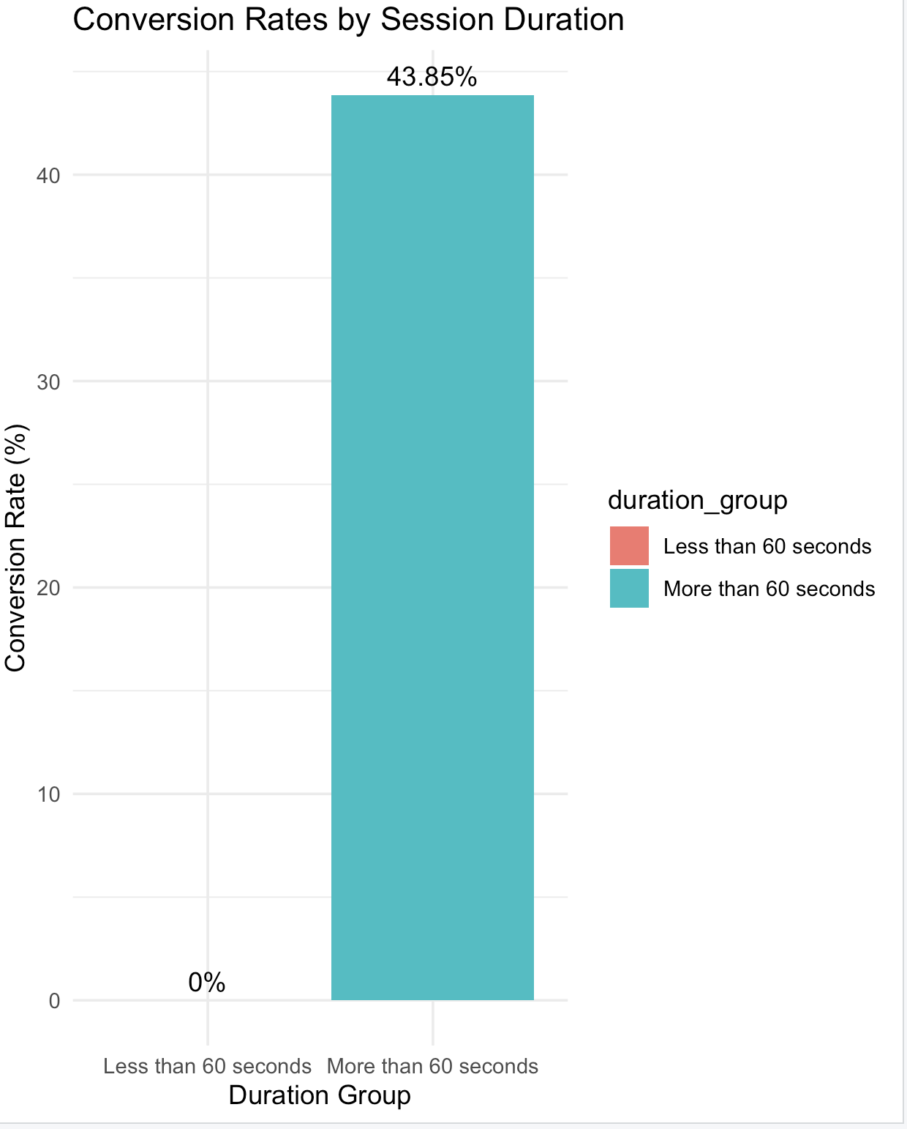
Conversion Rates
Amazon has the highest conversion rate amongst the three!
Customers browsing for less than 60 seconds most probably end up not buying!
Notes:
Mi

Slide 13
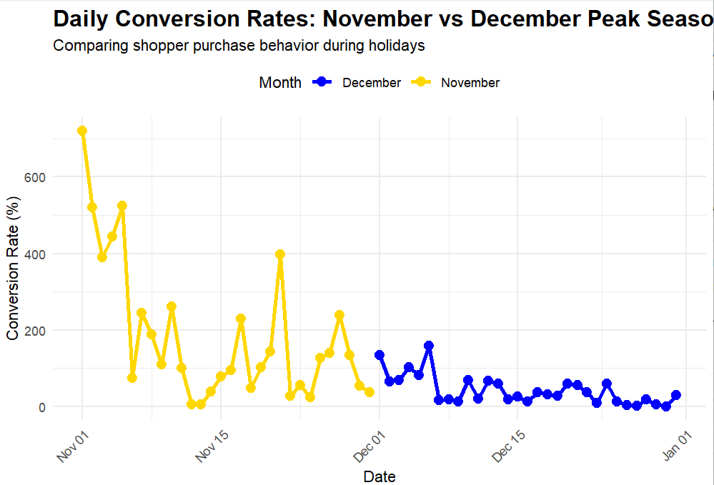
Conversion Rates of Two Peak Months of the Holiday Season
November's daily conversion rates are more volatile with higher peaks, signaling impulsive shopper behavior or successful promotions.
December's rates are steadier but lower, reflecting consistent yet cautious purchasing patterns.
Notes:
Mishika :
This slide talks about the conversion rate observed in peak holiday season. Despite fewer shopping sessions in November, the higher average conversion rate highlights a more decisive shopper intent compared to December's larger volume but lower conversion rates.

Slide 14
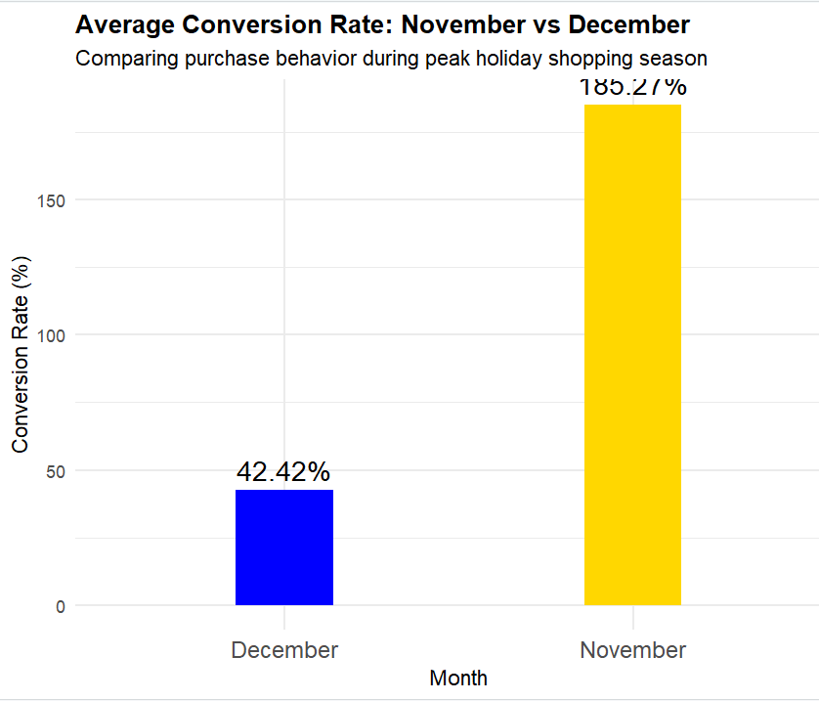
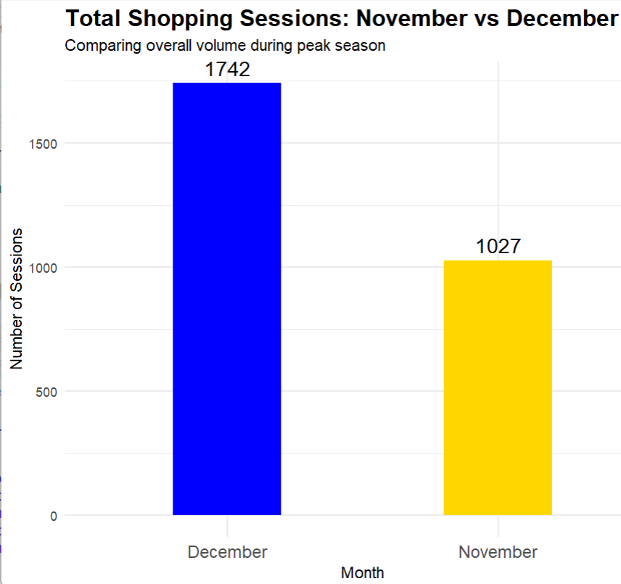
Conversion Rates of Two Peak Months of the Holiday Season
Despite fewer shopping sessions in November, the higher average conversion rate highlights a more decisive shopper intent compared to December's larger volume but lower conversion rates.

Slide 15
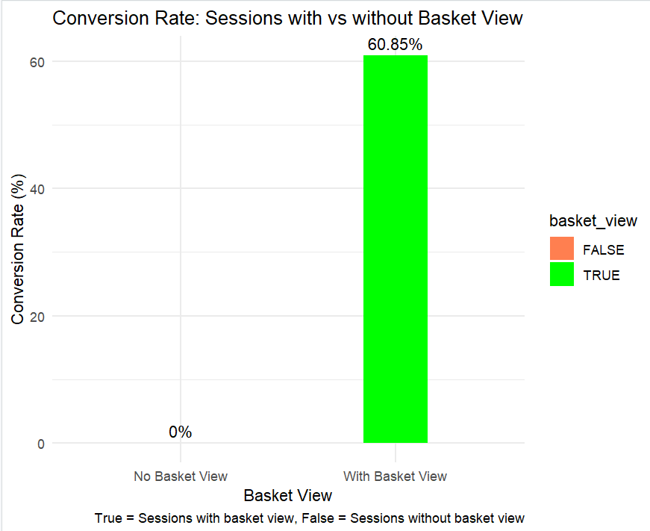
Conversion Rate for Basket View
For sessions where users saw their basket (TRUE), the conversion rate is 60.8%
For sessions without basket views (FALSE), the conversion rate is 0%
Notes:
Mishika: This makes sense from a business perspective - users who view their basket/cart are much more likely to complete a purchase than those who don't. The 60.8% conversion rate from basket view to checkout is actually quite strong, suggesting that once customers add items to their basket and view it, they're highly likely to follow through with the purchase.

Slide 16
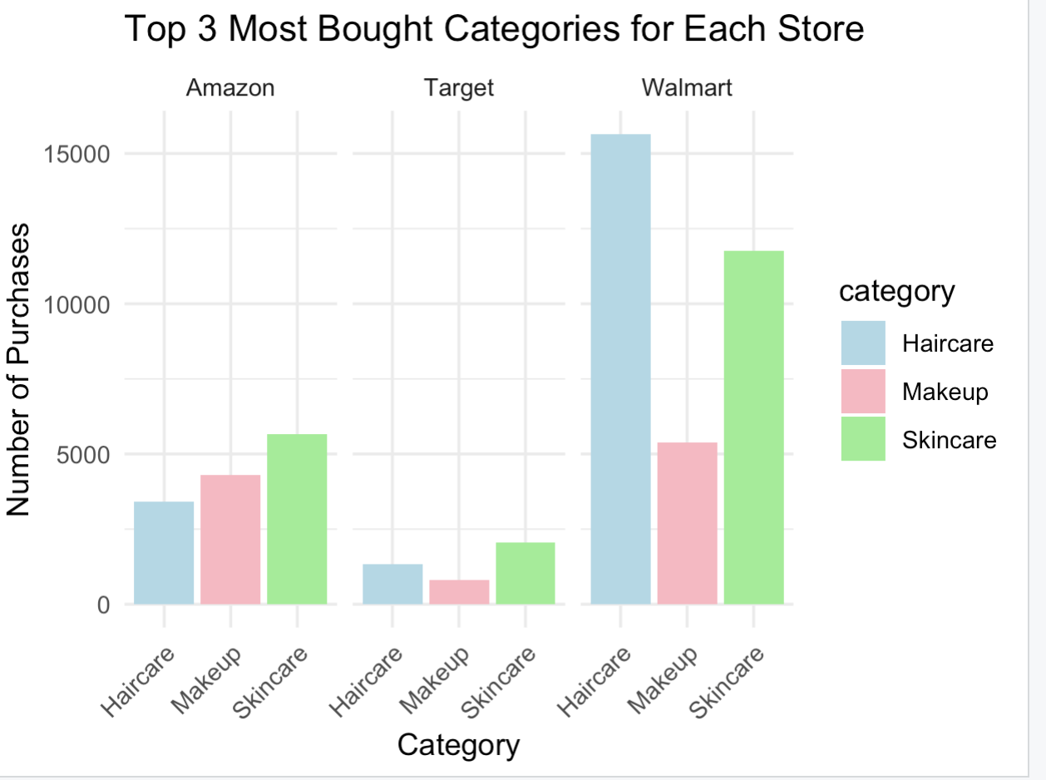
Top 3 Most Purchased Category By Retailer
Walmart has the highest total number of purchases, significantly outperforming the others.
In Walmart, Haircare is the top category, indicating strong demand in mass retail channels.
In Target and Amazon, skincare is the most purchased category.
Strategic Insight:
we can clearly suggest smarter product placement and inventory strategies for each retailer
Notes:
This slide shows the top three most purchased categories for each retailer. On the right chart, as you can see, Walmart has the highest total number of purchases, significantly outperforming the others.
What stands out here is that in Walmart, haircare is the top category. On the other hand, in Target and Amazon, skincare is the most purchased category.
So, through this analysis, we can clearly suggest smarter product placement and inventory strategies for each retailer.

Slide 17
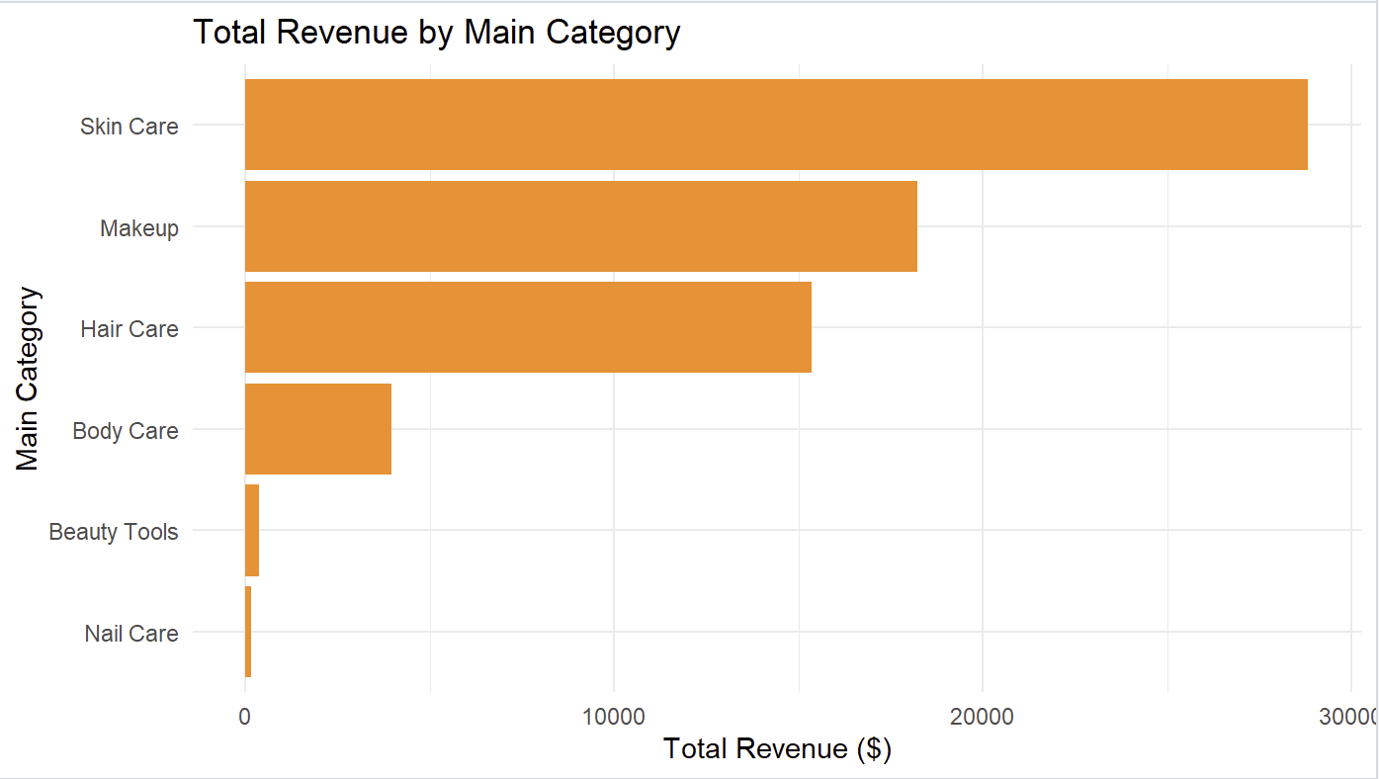
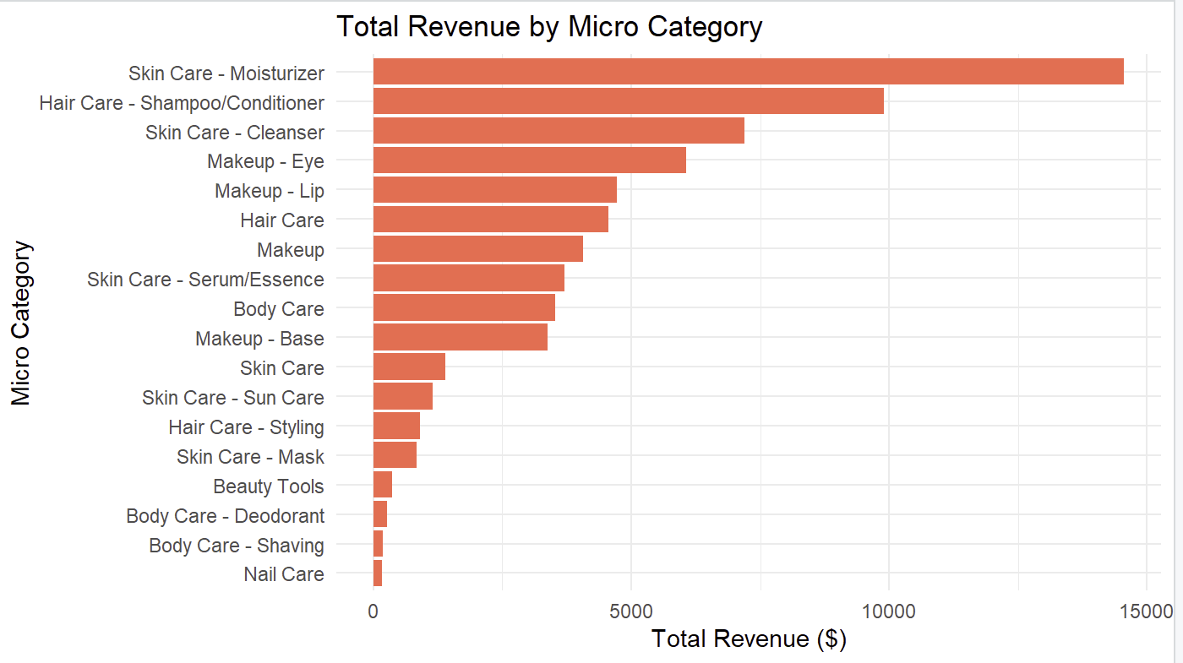
Total Revenue By Main & Micro Catergory
Skin Care generates the highest total revenue among all main categories, significantly outperforming other segments.
Makeup and Hair Care follow as the second and third top contributors to revenue, showing strong market presence.
Within micro categories, Skin Care - Moisturizer alone accounts for the largest revenue share, emphasizing its consumer demand.
Nail Care and Beauty Tools contribute the least to total revenue, indicating limited commercial traction in those areas.
Strategic Insight:
We can better focus future marketing and product development efforts by targeting the categories that promise the highest return on investment.
Notes:
As shown on the screen, this slide displays the total revenue by main and micro-category. The first chart represents the main categories, while the second chart shows the micro-categories. In the main categories, skincare generates the highest total revenue, followed by makeup and haircare. Within the micro-categories, moisturizers under skincare account for the largest share of revenue, while nail care and beauty tools represent smaller portions. Through this analysis, we can better focus future marketing and product development efforts by targeting the categories that promise the highest return on investment.

Slide 18
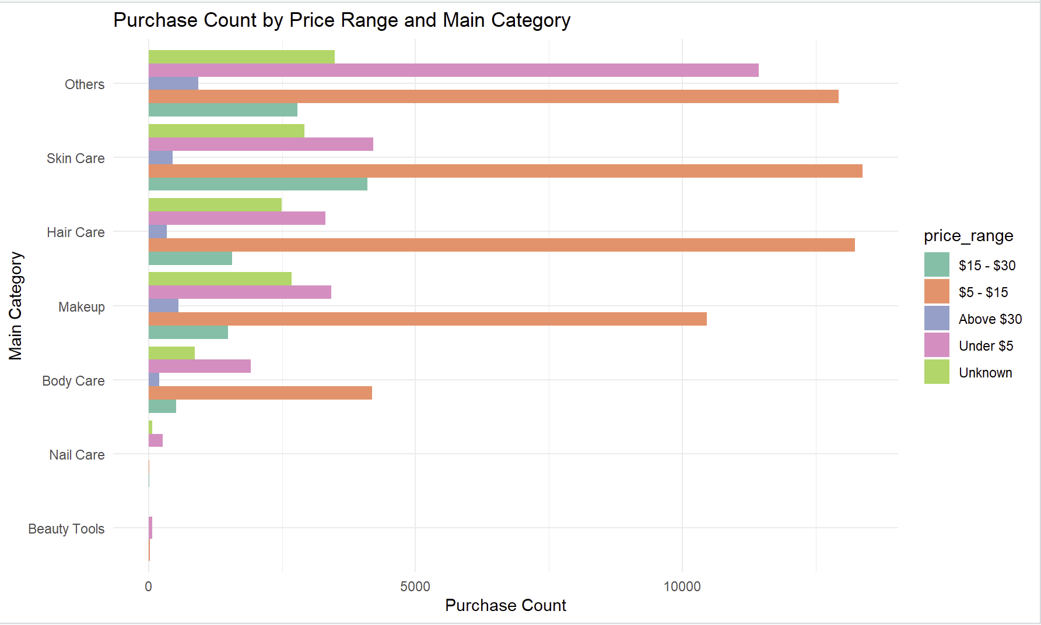
Purchase Count by Price Range
Most purchases occur within the $5–$15 price range across all categories.
Skin care, hair care, and makeup are the dominant categories in this range.
Premium-priced products (above $30) show limited sales activity, suggesting price sensitivity.
A non-negligible share of purchases is either under $5 or has an unknown price, possibly due to data limitations or bundled items.
Strategic Insight:
focusing on mid-priced products — between $5 and $15 — and strengthening the skincare, haircare, and makeup categories could help maximize sales opportunities across different channels.
Notes:
In this slide, we analyze the purchase count by price range. As you can see in the chart, most purchases occur within the five to fifteen dollars price range.
However, premium-priced products, such as those priced above thirty dollars, show limited sales activity.
Through this analysis, we found that focusing on mid-priced products and strengthening the skincare, haircare, and makeup categories could help maximize sales opportunities across different channels.

Slide 19
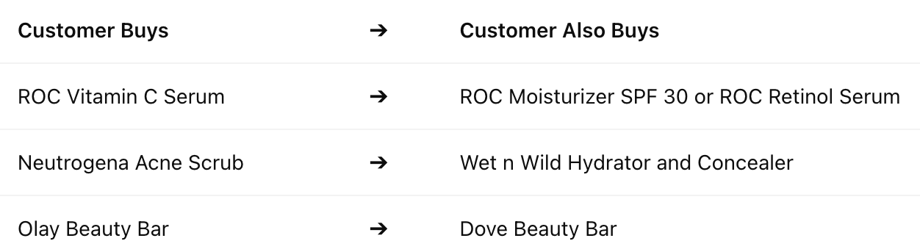
Basket Analysis
Insights
100% Confidence: RHS product always bought with LHS.
Lift Range: 245 to 850+ ➔ Extremely strong, non-random associations.
Examples from Data
ROC: Vitamin C Serum ➔ Moisturizer SPF 30 or Retinol Serum
Neutrogena: Acne Scrub ➔ Wet n Wild Hydrator and Concealer
Olay & Dove: Strong mutual purchasing of beauty bars
Suggestions for High Potential:
Bundling: Same-brand products (ROC, Dove, Garnier)
Cross-Brand Switching: Especially between Olay and Dove in the soap category.
Cross-Category Marketing: From skincare to makeup ( Neutrogena ➔ Wet n Wild)

Slide 20
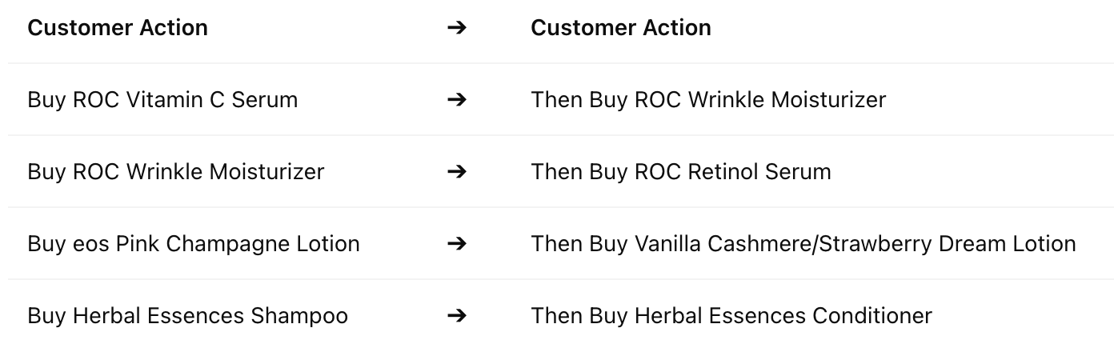
Key Patterns Identified
Strong cross-purchasing behavior among ROC brand products
Purchasing the ROC Vitamin C serum almost always leads to purchasing the ROC Wrinkle Moisturizer.
Similarly, purchasing the ROC Wrinkle Moisturizer often leads to the ROC Retinol Serum.
Significant cross-purchasing within eos body lotion products
Different scents (e.g., Pink Champagne, Vanilla Cashmere, Strawberry Dream) are often purchased together.
Other observations:
Cross-purchasing between Herbal Essences shampoo and conditioner sets was also detected.
Notes:
Slide Notes (English) ROC Skincare products show a strong "bundle buying" behavior, rather than single product purchases → Potential for bundling or set promotions. eos body lotions are often bought together in different scent combinations → Great opportunity for "gift set" marketing. Herbal Essences products also show opportunities for cross-selling within the hair care category. Overall, there is a high predictability in purchasing behavior within brands. The fact that many rules have a confidence of 1 indicates very strong, consistent purchase patterns.
Key Takeaway Customers exhibit strong cross-purchasing behaviors within specific skincare brands (especially ROC and eos), presenting opportunities to optimize bundling and cross-selling strategies.
슬라이드 노트 (한글) ROC 브랜드는 단품보다는 세트 구매 성향이 강하게 나타나며, 번들 프로모션에 유리함. eos 바디로션은 다양한 향 조합의 동시 구매가 많아, 선물세트 마케팅 전략에 적합. Herbal Essences는 헤어케어 범주 내에서 크로스 셀링 기회가 있음. 전반적으로 브랜드 내부에서의 구매 행동이 예측 가능성 높음. 여러 규칙에서 **신뢰도가 1(100%)**인 것은 매우 강하고 일관된 구매 패턴을 의미함.
핵심 요약 고객들은 특정 브랜드(Roc, eos 등) 내에서 강한 교차 구매 성향을 보이며, 이를 활용한 번들 판매 및 크로스 셀링 전략 최적화 기회가 존재함.

Slide 21
Thank you!

Slide 22
Annex

Slide 23
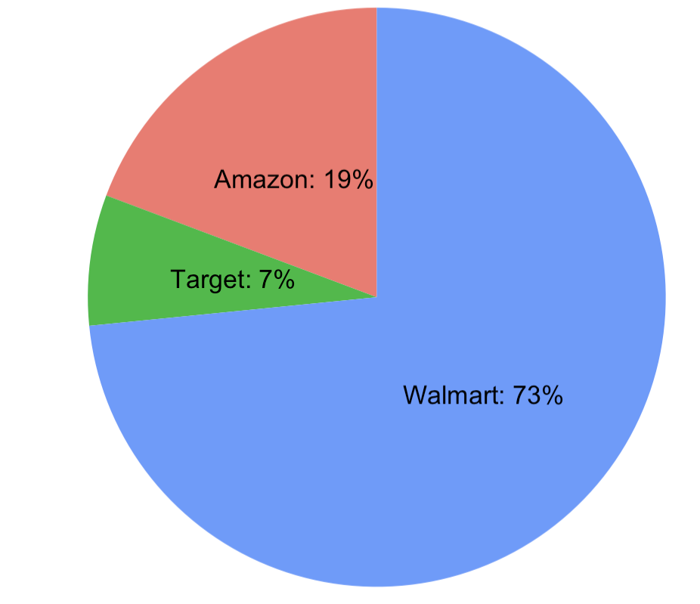
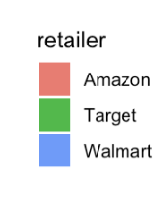
Matched Beauty Products by Retailer
Majority of beauty products were looked up in Walmart even though Amazon data was collected since May
Disparity between Target and Walmart could be attributed to the late addition of Target Data (Aug 2024 vs Oct 2024)
Notes:
May – July: Amazon only
August – September: Amazon + Walmart
October – present: Amazon + Walmart + Target.

Slide 24
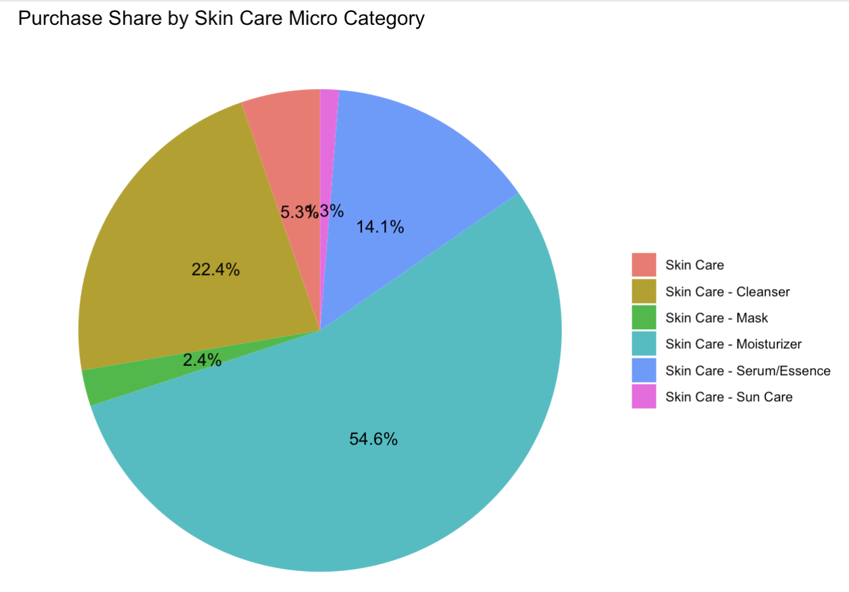
PURCHASE SHARE BY SKIN CARE
MICRO CATEGORY
Moisturizer makes up about 54% of skincare purchases
Followed by Cleanser and Serum
Notes:
This pie chart shows the distribution of purchases within the Skin Care category.
Moisturizers account for the largest share, indicating that hydration products are the most sought after by consumers.
Cleansers and Serum/Essence also contribute significantly, reflecting a strong interest in facial cleansing and skin improvement routines.
Meanwhile, Masks and Sun Care products make up a smaller portion of skincare purchases, suggesting that they may be used more selectively or seasonally.
These insights could help prioritize product focus in skincare marketing and inventory management.
JK

Slide 25
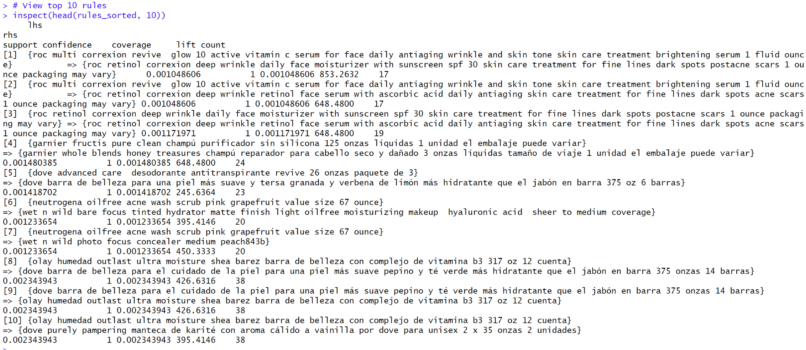
Top 10 High-Lift Association Rules from Basket Analysis

Slide 26
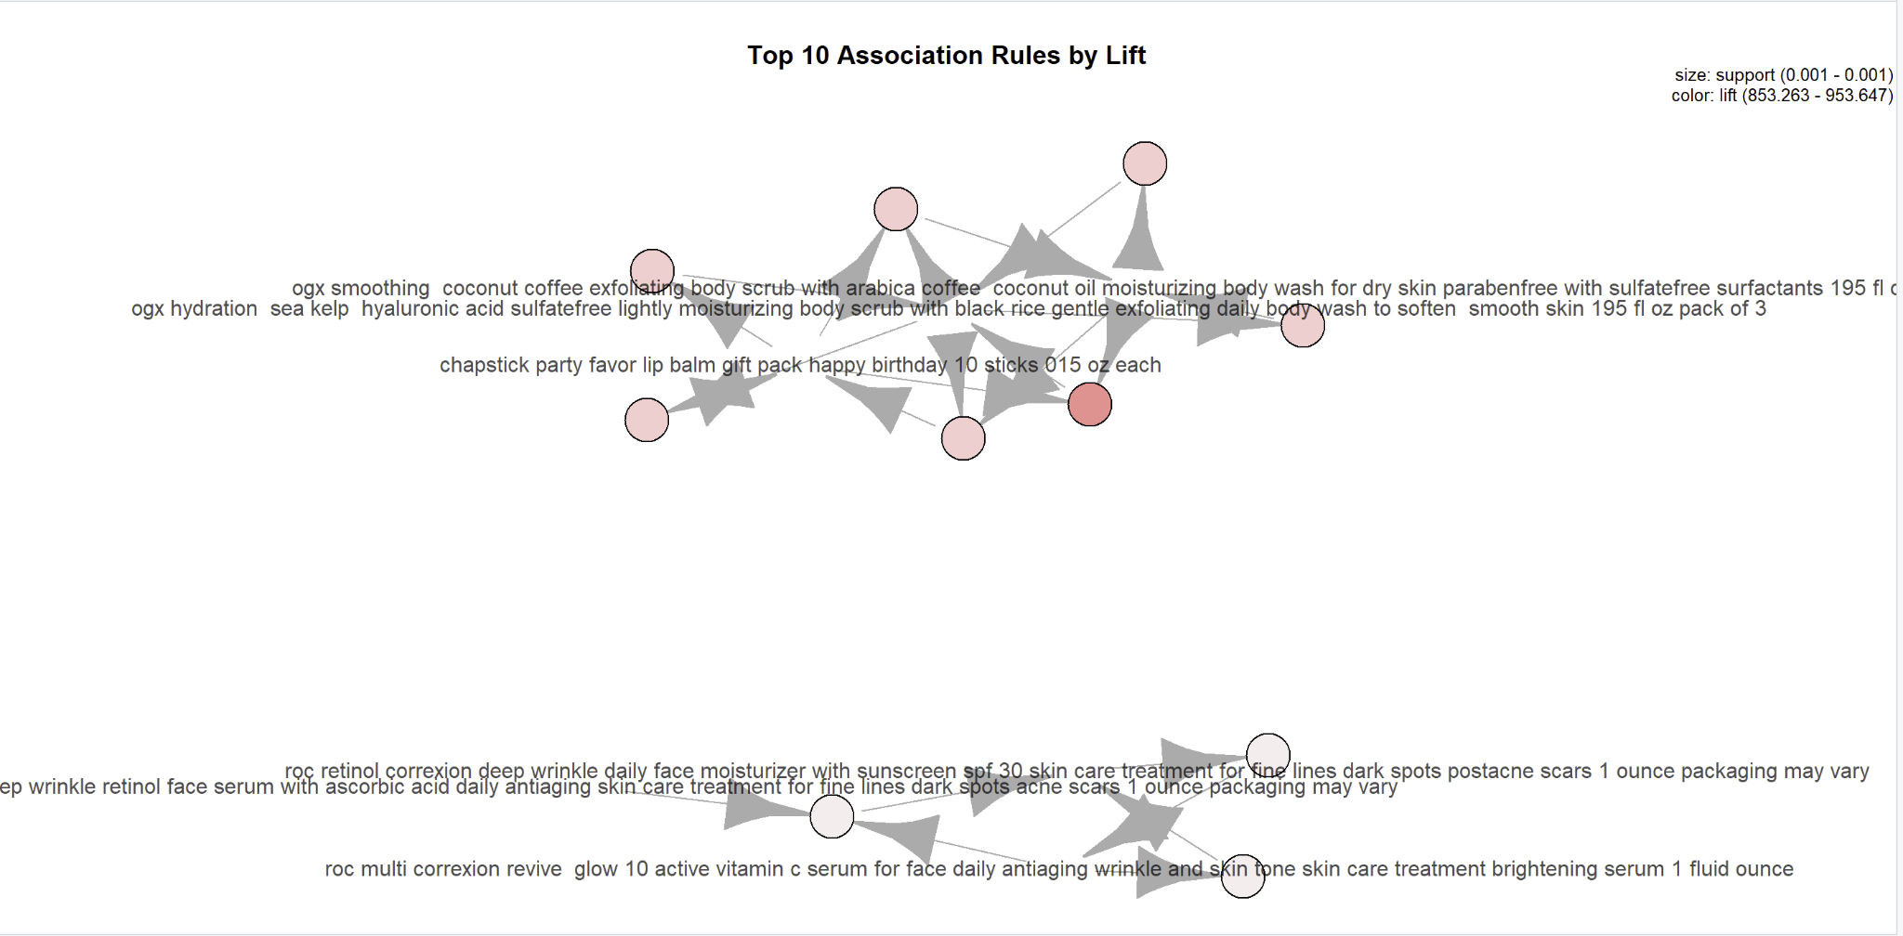

Slide 27
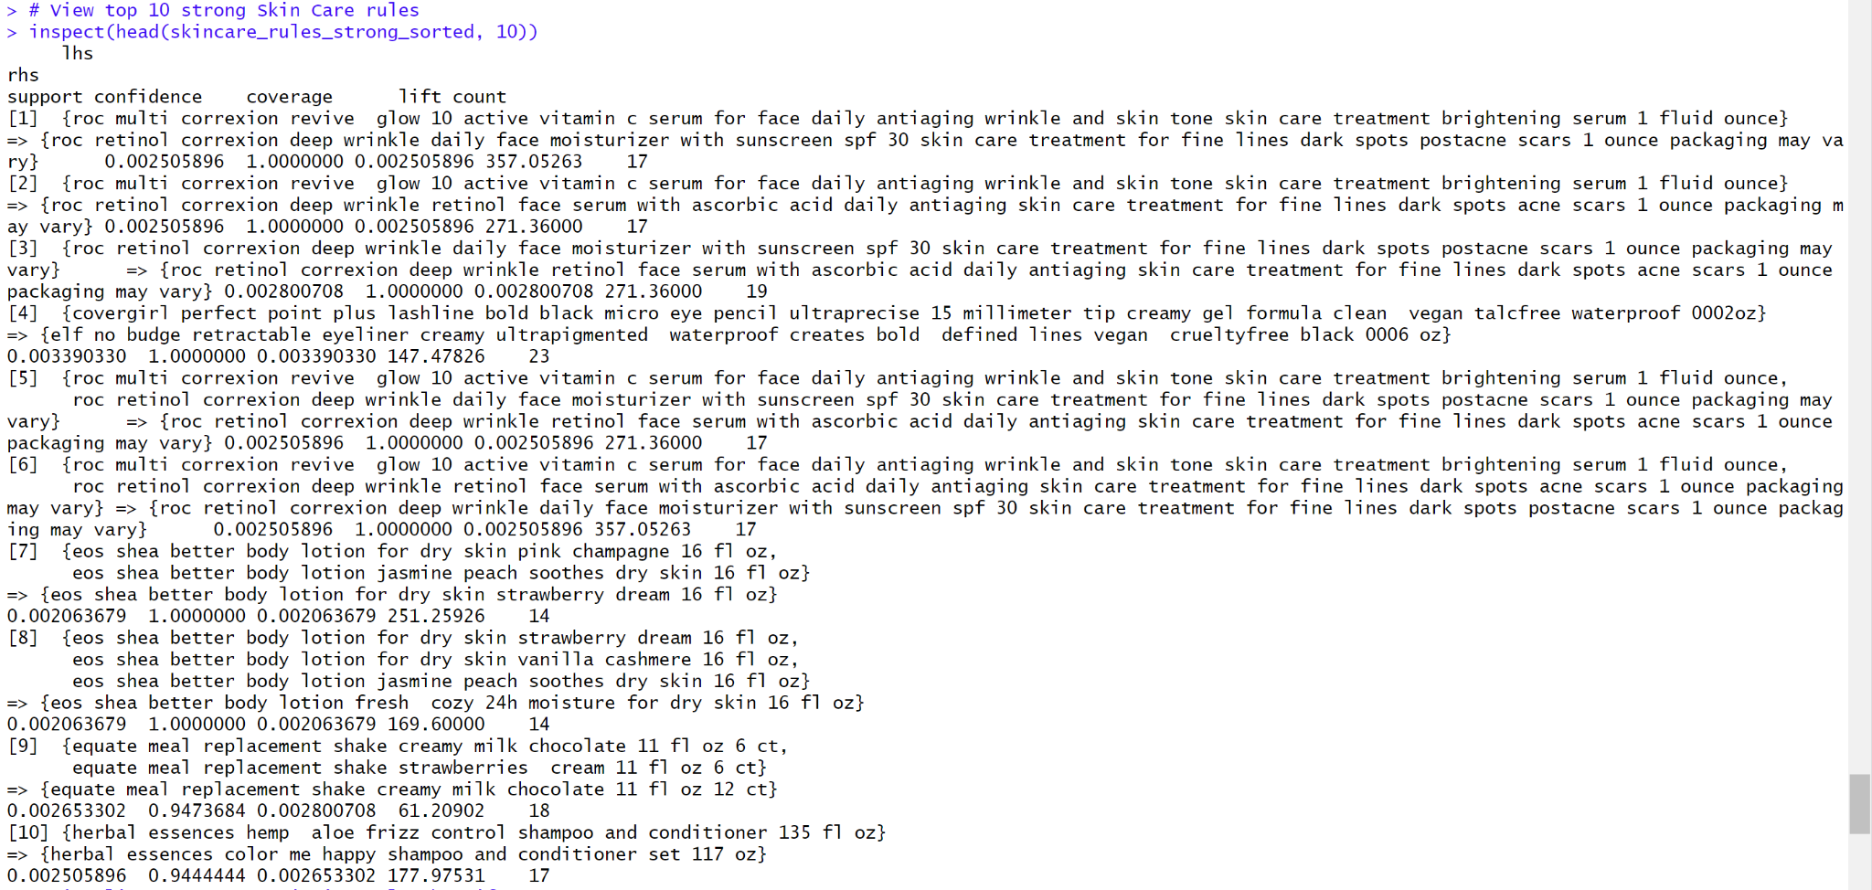
TOP 10 STRONG SKIN CARE ASSOCIATION RULES

Slide 28
